Slide 1
JHU BME 580.422 Systems Bioengineering II
Reza Shadmehr
Introduction to voluntary motor control:
Effort, reward, and dopamine

Slide 2
The basal ganglia, along with the posterior parietal cortex and the frontal lobe, assign value to the available actions (different movements that can be done).
We tend to produce a movement toward the stimulus that has the highest subjective value.
The relative value of the stimulus affects movement speed: we move faster toward stimuli that our brain assigns a greater value.
Because time discounts the value of the stimulus, the faster we acquire the rewarding stimulus, the better. However, fast movement require greater energy.
The utility of a movement is the sum of gains and losses of that movement, discounted by time. Reward we attain is the gain, the energy we spend is the loss.

Slide 3
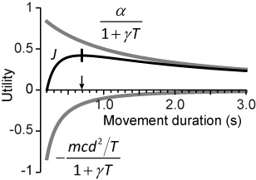
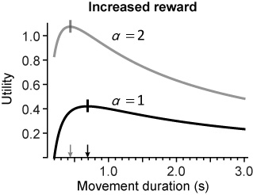
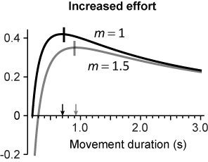
Movement utility as sum of reward and effort
reward
effort

Slide 4
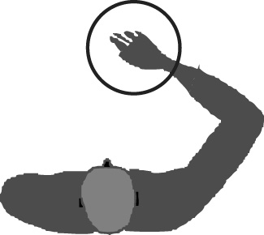
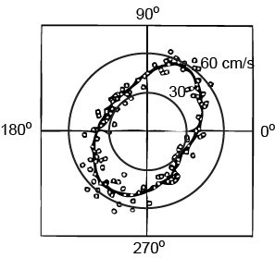
Reaching speed is slower for directions that have greater mass
Gordon et al. (1994)
They asked their subjects to make a single, uncorrected movement to a target at 10cm, with no time constraints on the movement.
Peak velocity

Slide 5
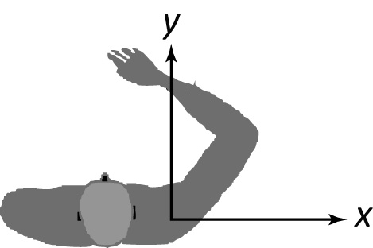
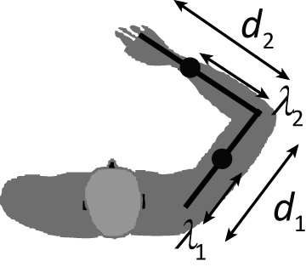
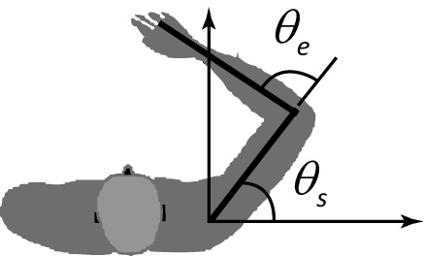
Estimating the mass of the arm for movements in various directions
1. Define the inertia of the arm
Length of the segment
Length to center of mass
Inertial of the arm
When the arm is in the horizontal plane, the inertia of the arm is a 2x2 matrix

Slide 6
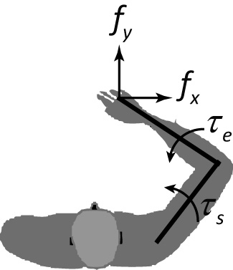
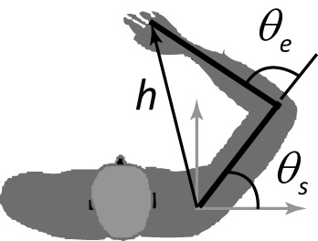
Estimating the mass of the arm for movements in various directions
2. Relate inertia of the arm to the effective mass of at the hand.
Location of the hand in Cartesian coordinates written in terms of joint angles
At rest, inertia describes the relationship between forces and torques in joint coordinates
Jacobian matrix
At rest, the mass matrix M describes the relationship between forces and acceleration in Cartesian coordinates

Slide 7
Estimating the mass of the arm for movements in various directions
2. Relate inertia of the arm to the effective mass of at the hand.
Force and torques are related by the Jacobian matrix
Motion at the hand is related to motion at the joints by the Jacobian
The above equation relates inertia H to mass M.
The mass at the hand M is a 2x2 matrix, relating acceleration of the hand to forces at the hand.

Slide 8
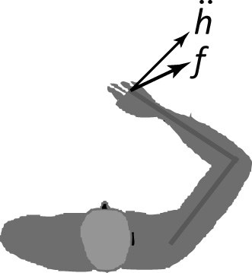
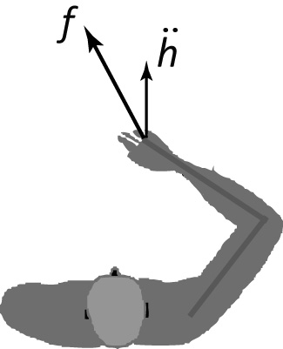
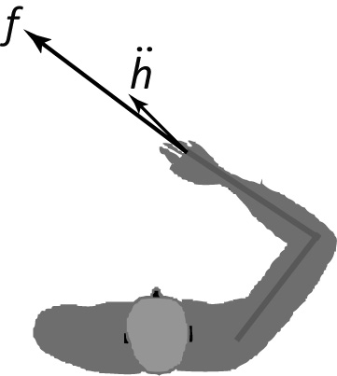
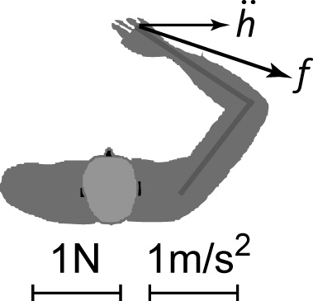
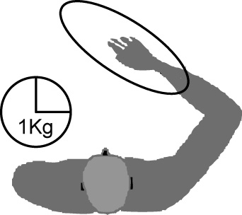
Estimating the mass of the arm for movements in various directions
Pick a unit length acceleration of the hand in direction p. Using the mass matrix we can compute the required force. The magnitude of the resulting force vector is the effective mass m for a movement in direction p.

Slide 9
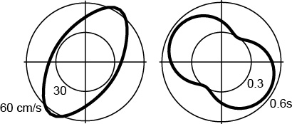
Reaching speed is slower for directions that have greater mass
Peak velocity
Utility
Peak velocity
Duration

Slide 10
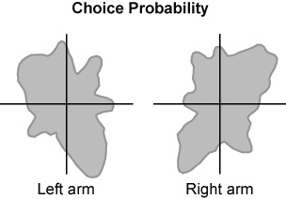
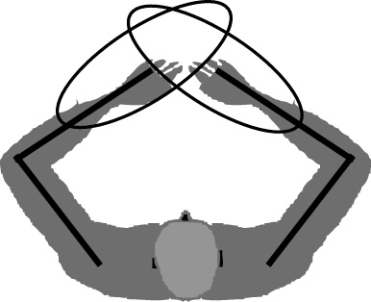
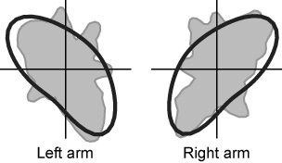
Probability of choosing a reaching direction is accounted for by
the utility of the movement
Increased mass makes the movement less valuable (utility of that movement is lower).
Utility
Subjects were asked to reach in any direction that they chose (out-and-back movements of constant amplitude). The investigators measure probability of the reach direction.
Goble et al. (2007)
Wang and Dounskaia (2012)

Slide 11
Summary
The utility of a movement is the sum of gains and losses of that movement, discounted by time.
Increased reward results in increased utility, making that action more preferable. Movement speed is higher toward things that have greater reward associated with them.
Increased mass results in smaller utility, making that action less preferable. Movement speed is lower toward things that require motion of a greater mass.

Slide 12
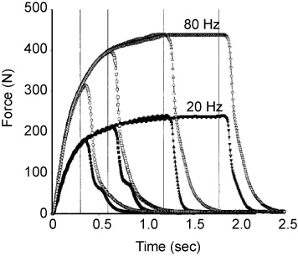
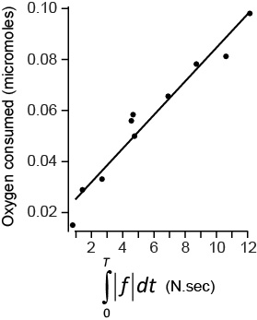
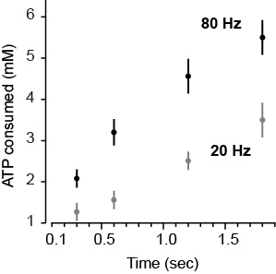
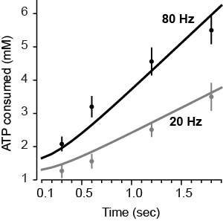
Metabolic cost of force production
Harkema et al. (1997) stimulated the intact human gastrocnemius and used NMR to estimate consumption of ATP
Energetic cost of force production
Kushmerick and Paul (1976): energy consumption in an electrically stimulated frog muscle

Slide 13
Perception of effort
The reward at stake
Energetic cost of force production
Utility of the action
Duration of the force production
Effort of the action
As duration of force production increases, effort does not continue to grow, but reaches an asymptote.
Prediction: perception of effort becomes indifferent to duration of force production as duration increases.

Slide 14
Implications of the theory
Kording et al. (2004) asked volunteers to hold force F1 for period T1, and then force F2 for period T2.
They then asked the volunteers to decide which action they would like to repeat, under the assumption that they would pick the one that is less effortful.
By manipulating F2 and T2, they computed an indifference point.
Effort of holding force F1 for period T1
Indifference condition
As duration T2 increases, F2 does not go to zero, but approaches a plateau that increases with F1.

Slide 15
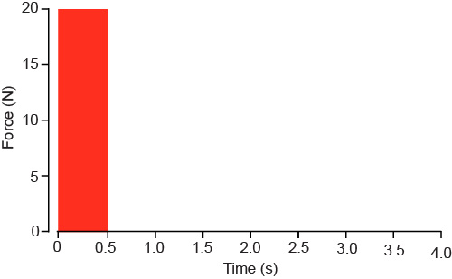
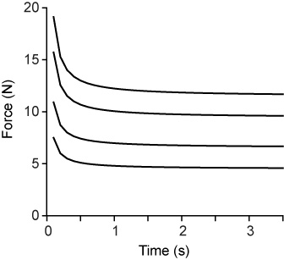
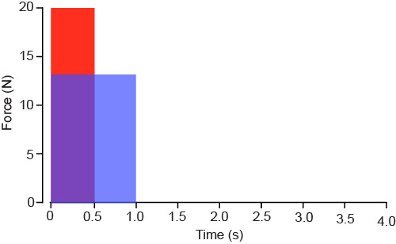
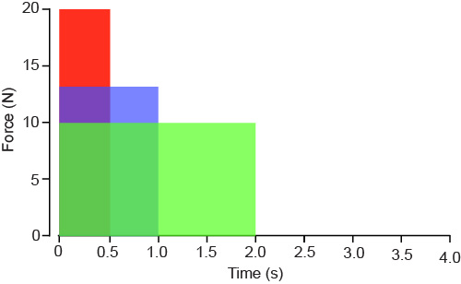
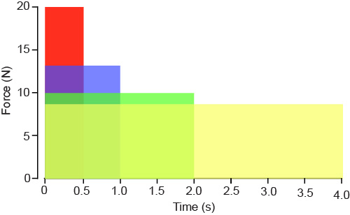
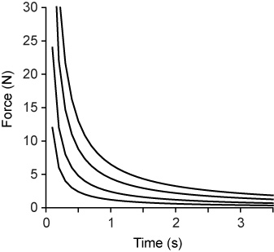
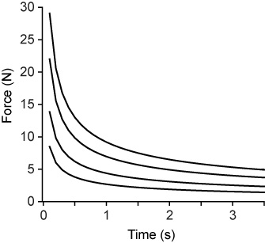
Implications of the theory
20N, 0.5s
13.3N, 1s

Slide 16
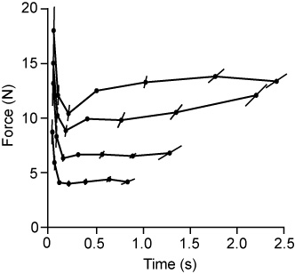
Comparison with experimental data
Kording et al. (2004)
The force-time indifference curves that people exhibit shows a curious pattern: perception of effort plateaus despite increased duration of force production.
This pattern is consistent with a perception of effort based on the metabolic cost of force production (the force-time integral), discounted hyperbolically with time.

Slide 17
Summary
The metabolic cost of force production appears to grow linearly with the integral of the force.
The utility of an action discounts effort by time. This means that if effort is related to the metabolic cost of force production, then its utility is a temporally discounted measure of the metabolic cost.
This makes the unexpected prediction that perception of effort does not increase linearly with duration of force production: we would rather produce a small force for a long time than a large force for a short time.

Slide 18
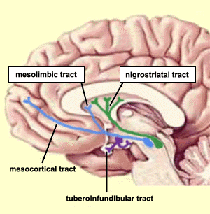
Encoding of reward and effort by the neurotransmitter dopamine
Dopamine releasing neurons have their cell bodies in the brain stem: substantia nigra and the ventral tegmental area. They project to three main areas: the striatum (nigrostriatal tract), the hippocampus (mesolimbic tract), and the prefrontal cortex (mesocortical tract).
Limbic system: hippocampus and the medial temporal lobe
Striatum (caudate and putamen, parts of the basal ganglia)
Prefrontal cortex
Substantia nigra
(part of basal ganglia)
Ventral tegmental area

Slide 19
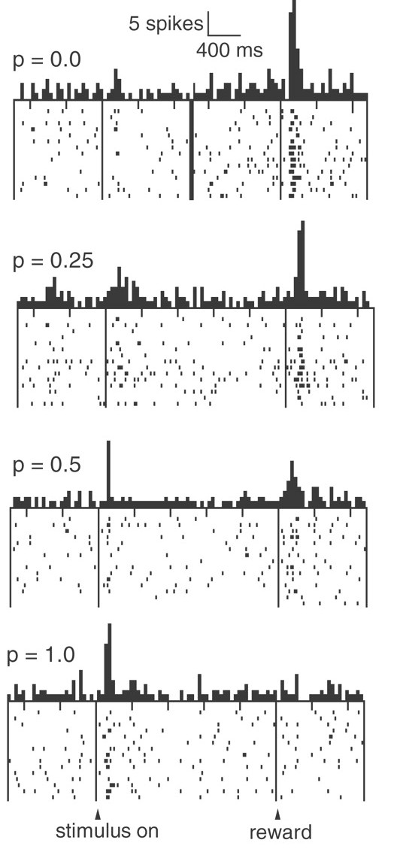
Dopamine signals whether a stimulus is expected to be rewarding.
This figure shows a dopamine neuron in substantia nigra
Monkey was trained to associate each of 5 distinct visual stimuli with probability of getting juice.
p represents probability of reward. In this case it is near zero. Therefore, when reward is given, it is unexpected. The cell responds not at all to the stimulus, but strongly after the unexpected reward is given.
In this case p is near 1. Therefore, when reward is given, it is expected. The cell responds strongly to the stimulus, but not at all after the expected reward is given.
Fiorillo, Tobler, and Schultz (2003) Science

Slide 20
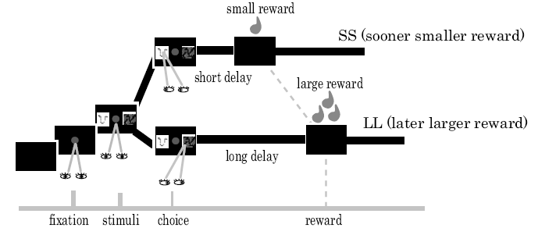
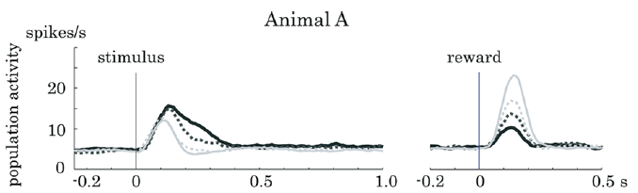
Dopamine cells encode temporally discounted reward
Short delay
Discharge with respect to
baseline at stimulus presentation
Long delay
Delay to reward (sec)
Kobayashi and Schultz (2008)
Notes:
Notice that for a smaller amount of juice, the initial discharge is smaller. Relate this later to alpha and Parkinson’s disease.

Slide 21
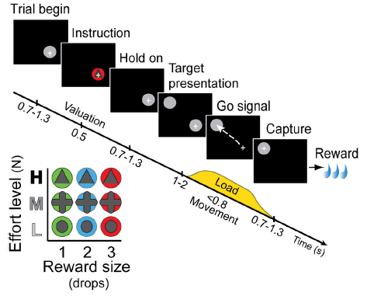
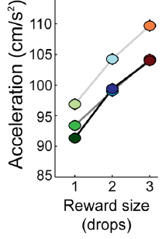
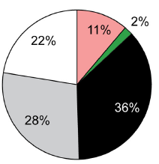
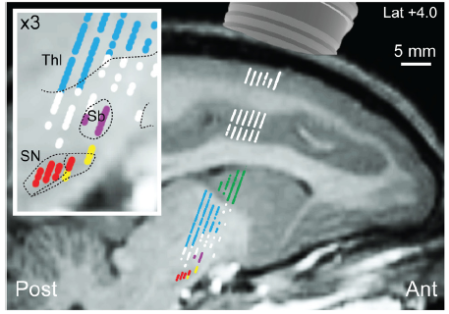
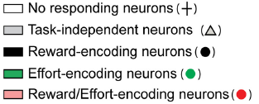
Dopamine cells also encode effort
Low effort
High effort
Pasquereau and Turner (2013)

Slide 22
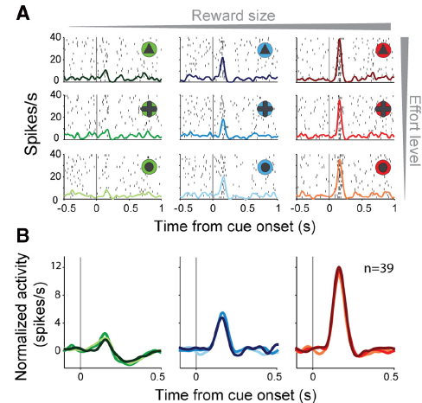
An example of a reward encoding dopamine cell
Pasquereau and Turner (2013)

Slide 23
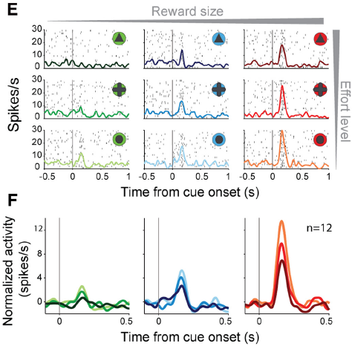
An example of a reward and effort encoding dopamine cell
Pasquereau and Turner (2013)

Slide 24
Parkinson’s disease
In PD, dopamine neurons in the substantia nigra degenerate and die.
Symptoms of the disease are slowness of movement (bradykinesia), resting tremor, rigidity of joints, and postural instability.
The slowness of movement in particular appears to be context dependent: the patient may run out the building in case of a fire, but otherwise will have trouble moving at normal speeds.
Treatments include dopamine replacement therapy.
Schizophrenia
Symptoms include hallucinations and delusions, including unrealistic beliefs like superpowers.
Pharmacological treatments that appear to help include dopamine antagonists, medication that blocks dopamine receptors.
A component of schizophrenia appears to be an over-active dopamine system.

